Slide 1
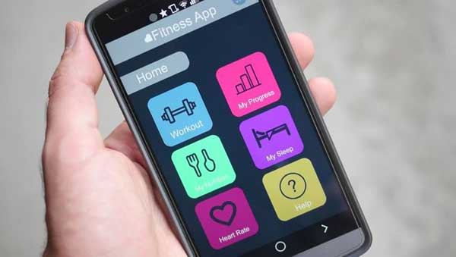
Fitness and Nutrition Buddy
By: Andy Hansana, Kevin Elliott, Ryan Crowley, Vincent Weaver

Slide 2
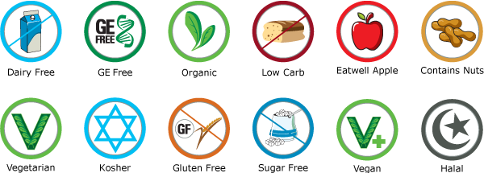
Overview
The fitness and nutrition buddy helps users get meal recommendations from restaurants that fit into their diet restrictions
Selection of meals is based on restaurants around their current location and what the restaurant serves
Users can set up custom diets such as low carb, low fat, keto etc…
Users track calorie intake in app and can see their stats from day to day

Slide 3
Description
The purpose of this application is to have a convenient way to have tailored custom meals created for you at the ease of your hands
The scope of this application is catered towards nutritional needs and fitness lifestyles.
The stakeholders included would be the client; any fitness companies (Gymshark, Nike, etc), customer; fitness enthusiasts; and users would include any adults involved with busy lifestyles that are watching their caloric intake.
Constraints would include specific devices that are tailored to run this application (Apple/Android)
Relevant facts and assumptions include all users are capable of navigating through mobile devices, and restaurants included in the application are those that provide accessible nutrition facts online.

Slide 4
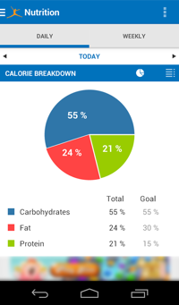
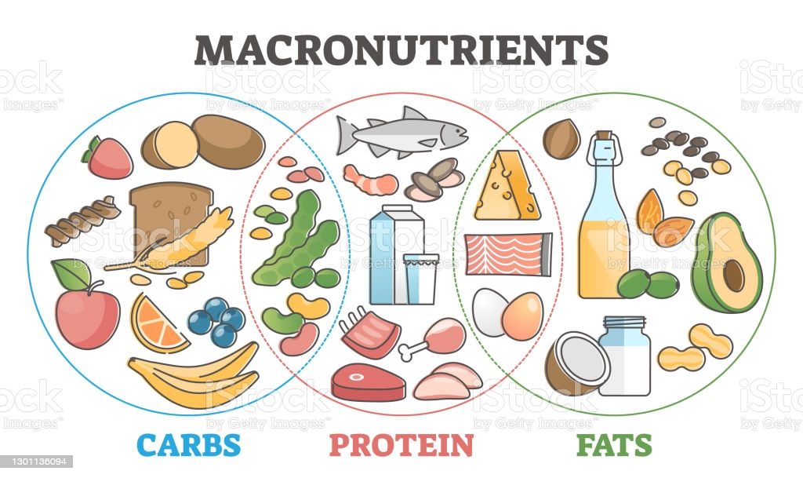
Definitions/Assumptions
“Macronutrients”:
A type of food that is required in large amounts in a diet (fat, protein, etc.).
“Macro calculations”:
Calculations performed with specific quantities of macronutrients that factor into the user’s nutrition plan.

Slide 5

Requirements
User requirements:
Supported OS: Android, iOS, Generally the most recent version + previous version
Downloaded Via: Apple App Store, google play store
App requirements:
Meal recommendations should take no more than a minute to compute in ideal conditions
User data is backed up daily to avoid major setbacks in progress
takes up no more than 50MB of space
servers are available 99% of the time or more
Monthly updates

Slide 6
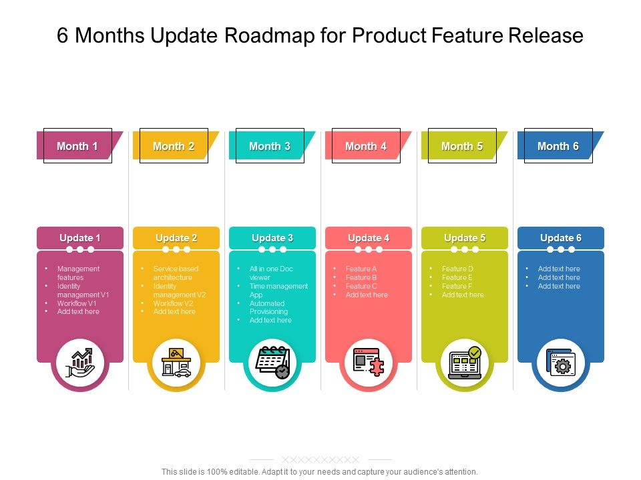
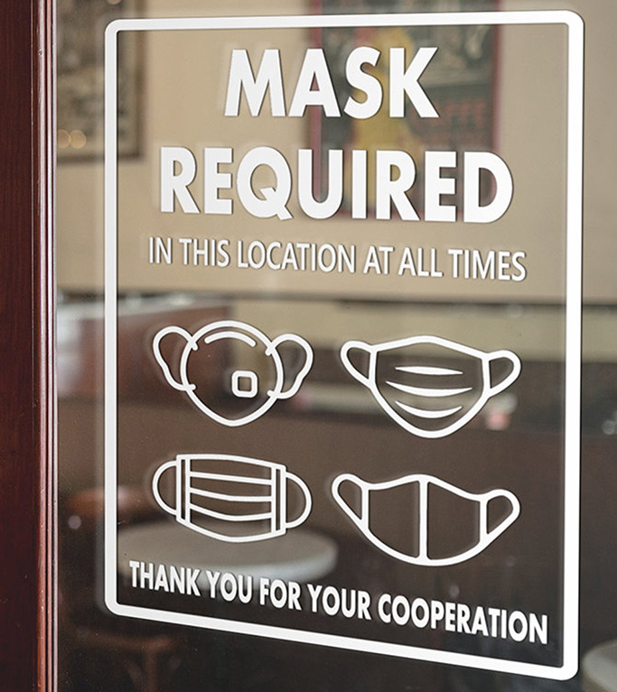

Responsibilities of the app
The app checks for any current health advisory and displays it to the public, such as a mask mandate, recent outbreak of a virus in certain foods, etc
Up to date and strong security for user data is used to protect sensitive health information
Availability anywhere that the app stores local terms of service allow for
Release of update notes and future update plans

Slide 7
Testing
The most tested part would be the meal creation and displaying due to complexity
#14 - Accurate Meals
Description: The user gets displayed meals that fit their macronutrients for the day
Rationale: If a user does not receive the appropriate meal they cant fit their diet
Fit Criterion: Every meal displayed must have their calories, carbs, protein and fat all under the remaining amount the user has for the day
Acceptance Tests: Meal Creation test

Slide 8
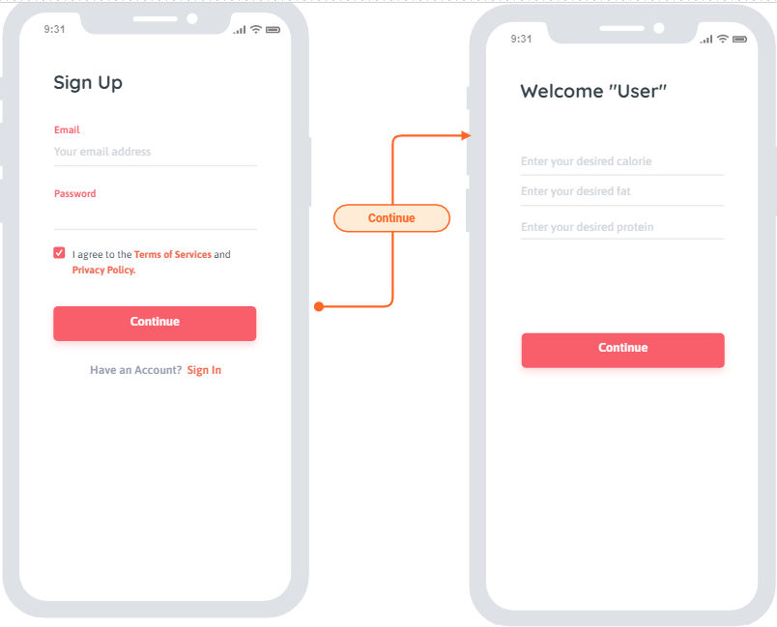
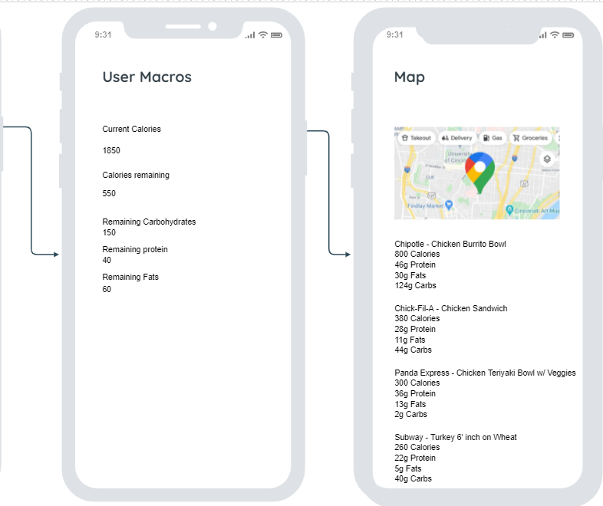
UI Design

Slide 9
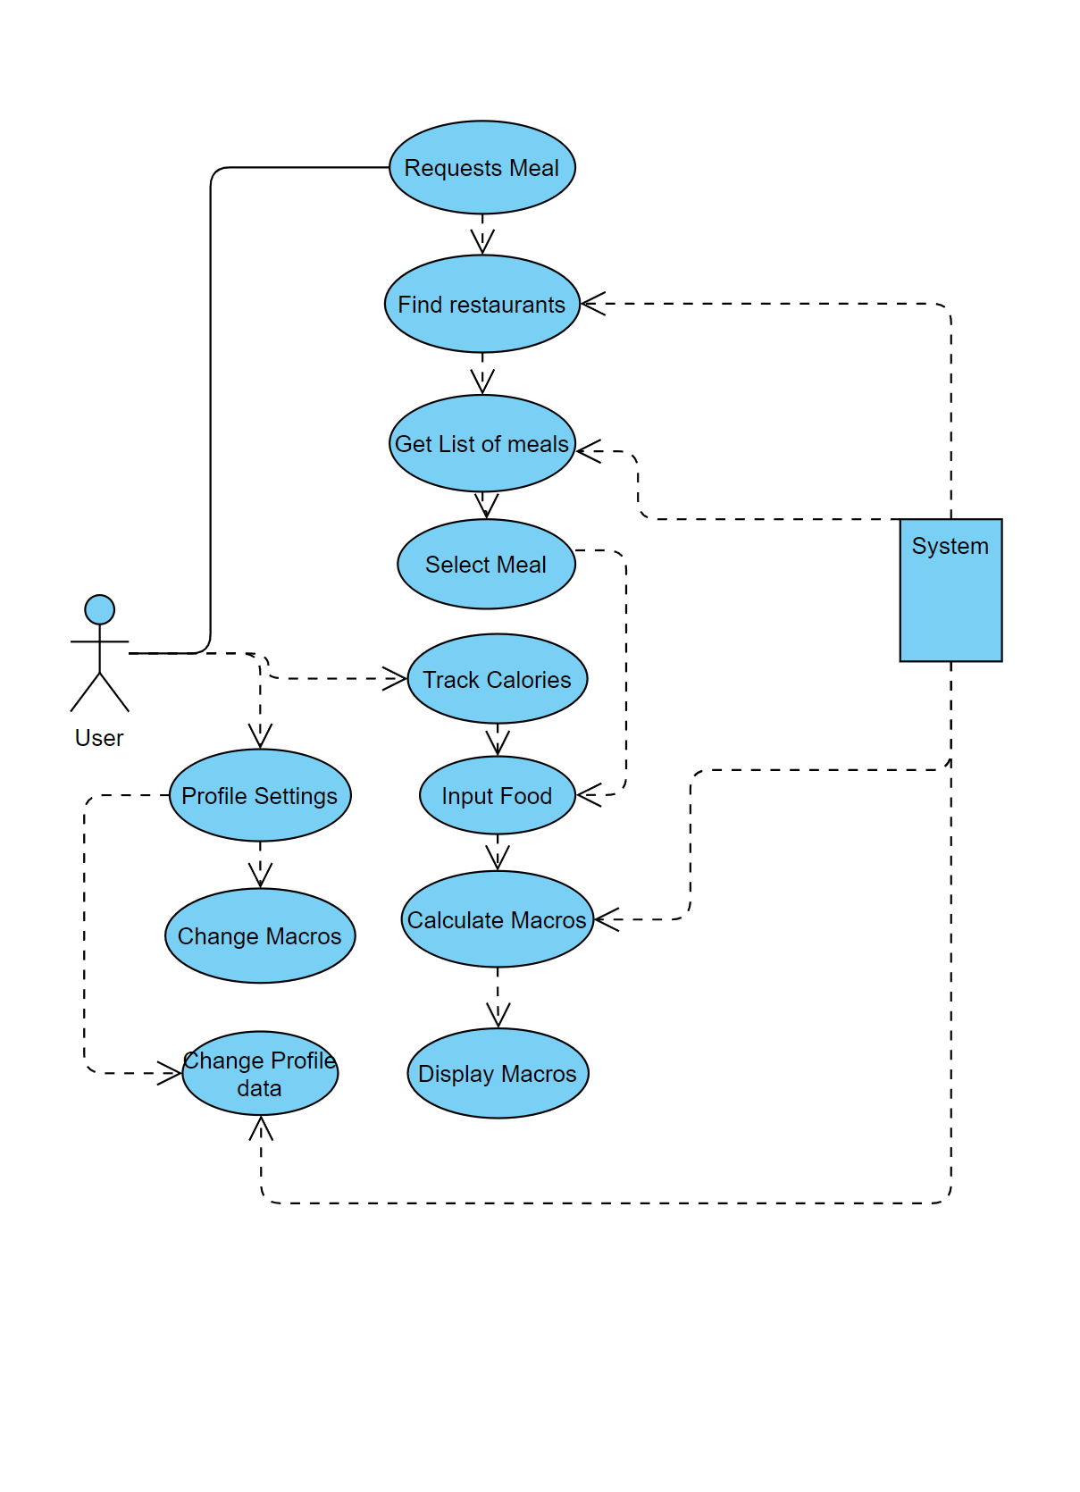
App flow
User can request a meal and then add that meal to their food list
Otherwise they can just add food manually
Changes to profile update the macros and re calculate them
Server

Slide 10
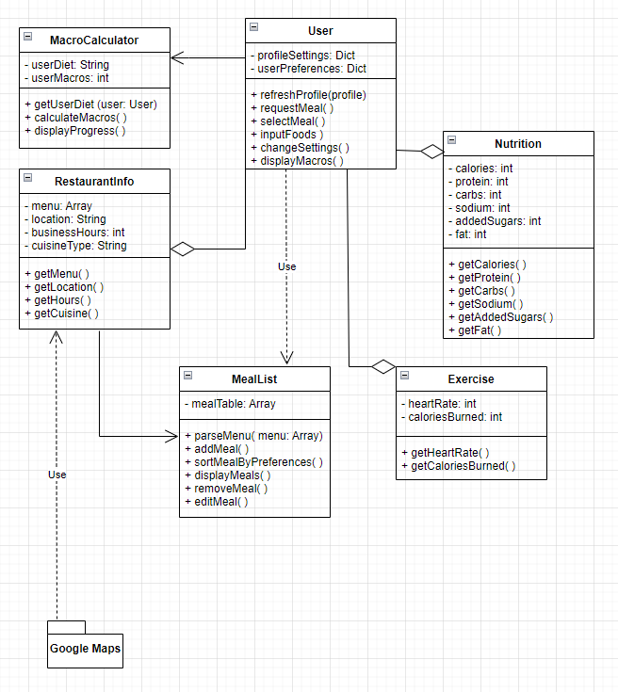
UML Diagram
User class handles preferences and other user-specific data. Along with requesting meals
Application is broken into different aspects (i.e. Nutrition and Exercise)
List of meals is generated to be displayed to the user using MealList

